Slide 1

TABLEAU in wondeRland
Not a fantasy!
Mufeng Zou

Slide 2
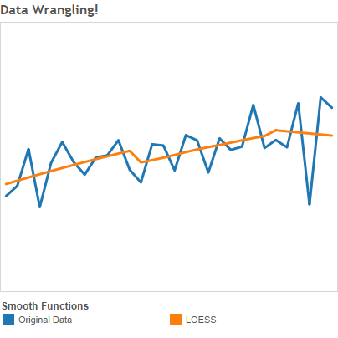
The Idea
Tableau
Visualization!
Lack of analytics functions…
R
Data analysis!
Take time to create charts…
Connect Tableau with R server!
One-line setup: Rserve::Rserve()
Easy charts
Interactive
Online analytics
+ Cambrian!
…and much more!

Slide 3
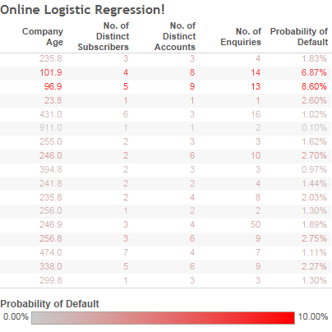
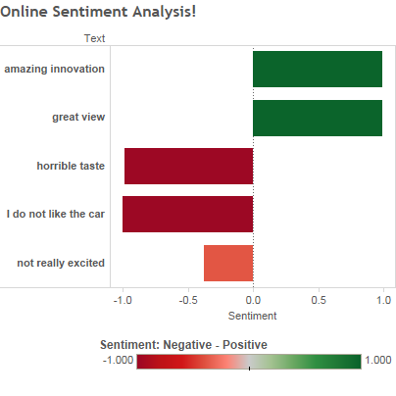
Online Models

Slide 4
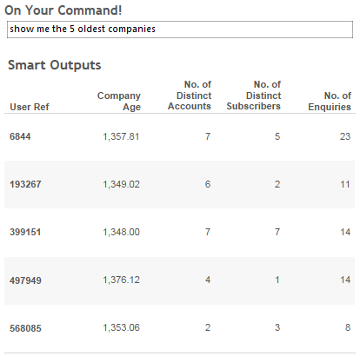
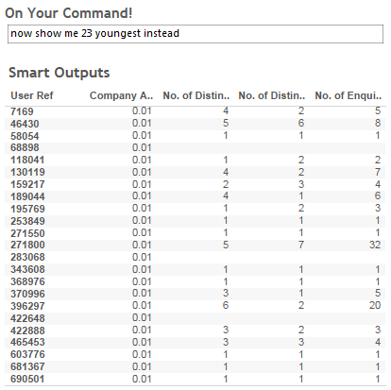
Dashboards that understand your words!

Slide 5
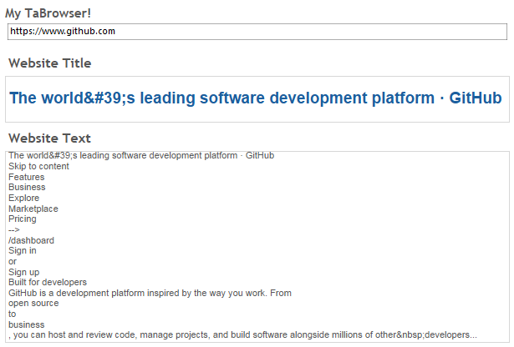
Behold… The Tableau Browser!

Slide 6
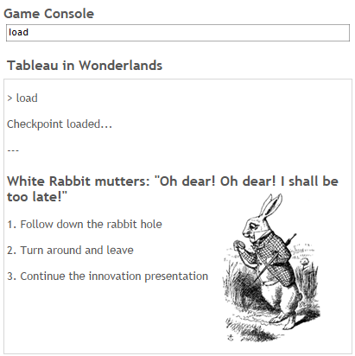
Or, would you like a game?
Using R scripts that write each run to external files…
Now Tableau can “remember” your previous inputs and game states!

Slide 7
Reference
If you have Tableau Desktop, you can try the dashboards here after starting R server on your local machine by running in R/RStudio:
>>> Rserve::Rserve()
Have fun!

